Slide 1
KYA Class Curriculum: Kentucky Youth Assembly; An Exploration of History, Politics, and Self-Government
WEEK ONE ANCILLARY MATERIALS

Slide 2
What would life be like if everyone had TOTAL FREEDOM and there was no government, no laws, no police, and no enforcement systems whatsoever?

Slide 3
State of Nature:
A condition of unrestricted freedom (chaos) in which there are no recognized constraints on anyone’s behavior beyond what can be compelled by force.

Slide 4
Social Contract:
A written or unwritten arrangement in which members of society give up a certain amount of freedom in exchange for safety and order.

Slide 5
What did he say?!
“OH NO HE DIDN’T!”
“SHADE” “CALLED HIM OUT!” “BURN NOTICE”
“CA$H ME OUTSIDE” “LET HIM HAVE IT”
“GAVE HIM THE WHAT FOR!”

Slide 6
Parts of Declaration of Independence
*Preamble: basically lays out why the 13 Colonies felt the need to issue a declaration…here’s why we’re doing this!
*Rights: basic statement of the rights of the “People”, including their right to self-government. Probably the single most well-known portion of the thing.
*Grievances (G1-G7): The bulk of the document is a laundry list of the failings of King George as a monarch…basically, “here’s why you stink and wont’ be our king anymore!”
*Declaration: this end part is where the actual “declaring” of independence takes place. In law-writing it is known as the “operative clause”, the language that directly says what action is officially being taken.

Slide 7
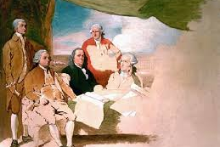
Do you recognize any of the people in the painting?

Slide 8
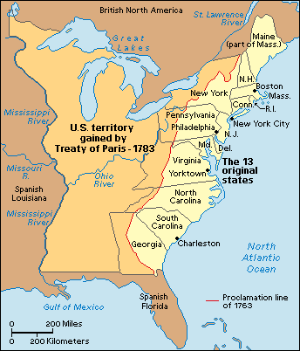
North America After Treaty of Paris, 1783

Slide 10
Please take out your maps from yesterday. USING PENCIL!, do your best to draw in from memory the boundaries of the States of Kentucky, Tennessee, Ohio, Indiana, and any others you think you can manage!

Slide 11
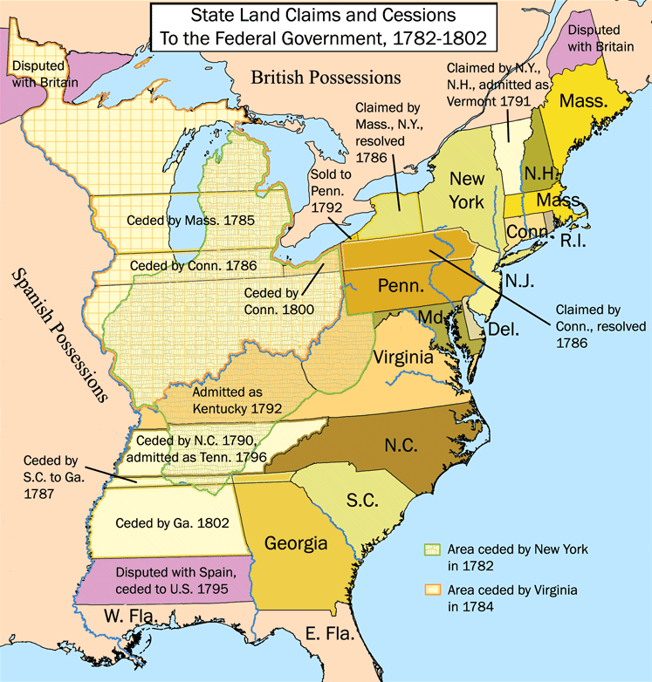

Slide 12
Northwest Ordinance of 1785:
passed under the “Confederation Congress” of the Articles of Confederation, it established that land would be sold to private citizens and then new territories admitted as co-equal states of the Union.

Slide 13
US Constitution (1789):
Article IV, Section 3: “New States may be admitted by the Congress into this Union;”
Article IV, Section 4: “The United States shall guarantee to every State in this Union a Republican Form of Government.”

Slide 14
Federalism:
a system of government in which power is shared and distributed between a central government and the constituent local/state governments.

