Slide 1
Virtual KUNA 2021 Parade of Nations Slide and World Expo Fact Sheet Slide Templates
Please use these example as a template for your country’s Parade of Nations &World Expo Fact Sheet Slide submission!

Slide 2
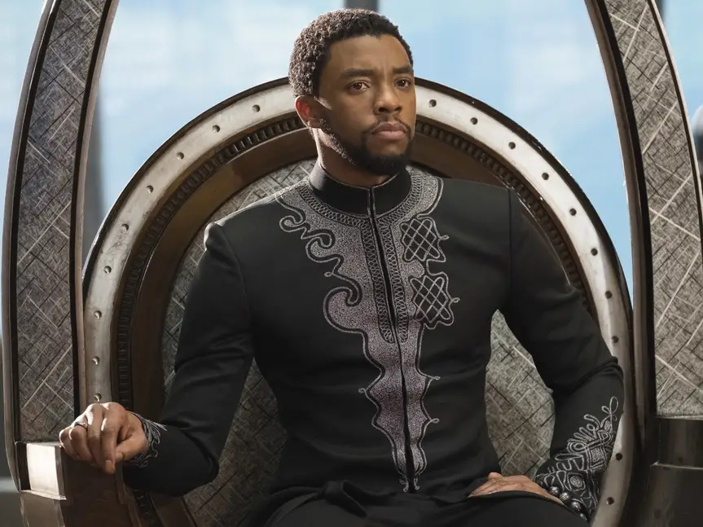
Wakanda
Continent: Africa
Population: 6,000,000
Per Capita GDP (US$): $838,000,000
Literacy Rate: 98%
Top Economic Activities: literally just vibranium
tt
Most Essential Import: Accepts No Imports
Government System: Absolute Monarchy
Major Languages: Wakandan, Yoruba, English
Major Religions (%): Panther Cult (69%), White Gorilla Cult (29%), Judaism (2%), Other (1%)
Current Head of Government: Black Panther (T’CHalla)
Head of State: King T’Challa

Slide 3
FLAG IMAGE HERE
Country Sign Image Here

